Slide 1
Power BI REST API with Power Query optics
„Make your data shine!“
2022

Slide 2







SPEAKER
ŠTĚPÁN REŠL
Zkušenosti VBA programování Power Platform konzultant
Power BI konzultant
Power BI školitel
Power BI mentor
Zkušenosti Business analýza
Project management
Power Platform Lead
Portfolio management
COO

Slide 3
AGENDA - What is Power BI Rest API - Dataset ID - Access token - IDs & Secrets - Production time - Template

Slide 4
WHAT IS POWER BI REST API

Slide 5



REST API
GET
POST
HTTP REQUEST
PUT
HTTP RESPONSE
DELETE
*PATCH
JSON | XML | HTML

Slide 6










POWER BI REST API
GET| POST | PUT | UPDATE | DELETE
Power BI REST APIs for embedded analytics and automation - Power BI REST API | Microsoft Docs

Slide 7
POWER BI REST API
Hey ... API gives me a refresh history of my dataset
curl --location -g --request GET 'https://api.powerbi.com/v1.0/myorg/admin/datasets/{datasetId}/refreshes' \
--header 'Content-Type: application/json' \
--header 'Authorization: Bearer {token}' \
--data-raw ''

Slide 8
POWER BI REST API
curl --location -g --request GET 'https://api.powerbi.com/v1.0/myorg/admin/datasets/{datasetId}/refreshes' \
--header 'Content-Type: application/json' \
--header 'Authorization: Bearer {token}' \
--data-raw ''
WHERE TO GET THEM?

Slide 9
DATASET ID

Slide 10

HOW TO GET DATASET ID?
Step by Step
Shortcut

Slide 11
DATASET ID – STEP SOLUTION
*Expand
Give me ALL Workspaces or by Specific Name
Return me content of Workspace
Give me Refresh history of Dataset from selected Workspace

Slide 12
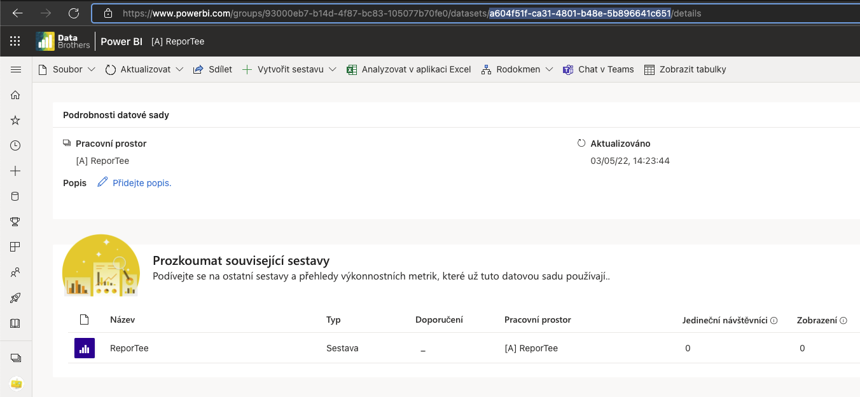
DATASET ID – SHORTCUT

Slide 13
Access Token

Slide 14


BUT TO ACCESS IT?
RESPONSES
USER
ACCESS TOKEN
SERVICE PRINCIPAL
RESPONSES

Slide 15

Oauth as Service Principal
ACCESS TOKEN
AUTHORIZATION
REQUEST WITH ACCESS TOKEN
RESPONSE
IDENTITY

Slide 16
Authentification Endpoint?
?
curl --location --request POST 'https://login.microsoftonline.com/{tenantID}/oauth2/token' \
--header 'Content-Type: application/x-www-form-urlencoded' \
--data-urlencode 'grant_type=client_credentials' \
--data-urlencode 'client_id={clientID}' \
--data-urlencode 'client_secret={clientSecret}' \
--data-urlencode 'resource=https://analysis.windows.net/powerbi/api'

Slide 17

And now in Power Query
M IS FOR MAGIC!!!

Slide 18
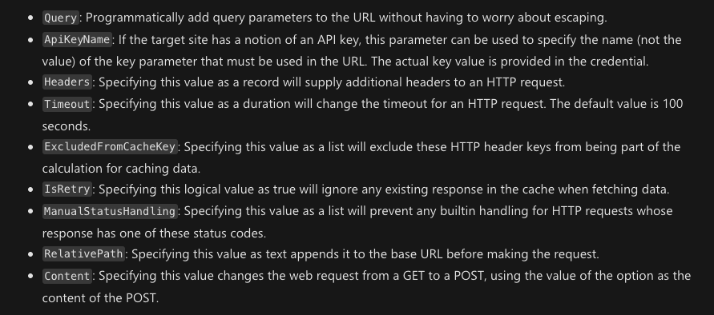
POST in Power Query?
Web.Contents( url as text, optional options as nullable record )
Web.Contents - PowerQuery M | Microsoft Docs

Slide 19
POST in Power Query?
Web.Contents( ”https://www.testURL.com”, [ Headers = [ #”Content-Type” = “application/json”
],
RelativePath = “api/admin/users”,
Content = Text.ToBinary(””) ] )
Even with blank content, will the call be executed as the POST method. Not as GET.
Web.Contents - PowerQuery M | Microsoft Docs

Slide 20
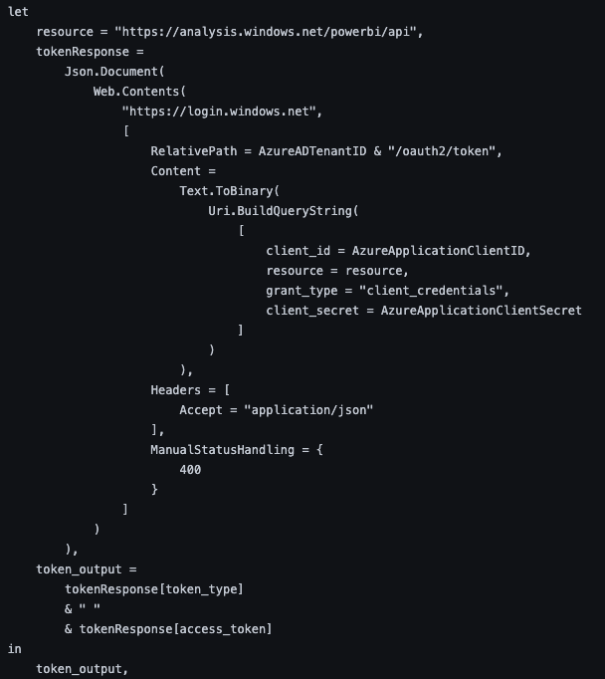
Oauth with Power Query
URL
RELATIVE PATH
BODY OF CALL
HEADERS
curl --location --request POST 'https://login.microsoftonline.com/{tenantID}/oauth2/token' \
--header 'Content-Type: application/x-www-form-urlencoded' \
--data-urlencode 'grant_type=client_credentials' \
--data-urlencode 'client_id={clientID}' \
--data-urlencode 'client_secret={clientSecret}' \
--data-urlencode 'resource=https://analysis.windows.net/powerbi/api'
Power_BI_REST_API_PQ/get-BearerToken.pq at main · tirnovar/Power_BI_REST_API_PQ (github.com)

Slide 21
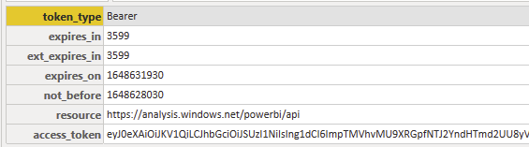
JSON RESPONSE (CONVERTED)
!!!!!!!

Slide 22
Oauth with Power Query
ACCESS TOKEN BUILDER
Power_BI_REST_API_PQ/get-BearerToken.pq at main · tirnovar/Power_BI_REST_API_PQ (github.com)

Slide 23
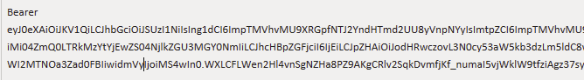
COMPLETED RESPONSE
TOKEN TYPE
ACCESS TOKEN

Slide 24
Oauth with Power Query
RESOURCE IS HERE
WHERE I CAN GET THESE???
Power_BI_REST_API_PQ/get-BearerToken.pq at main · tirnovar/Power_BI_REST_API_PQ (github.com)

Slide 25
IDS & SECRETS

Slide 26
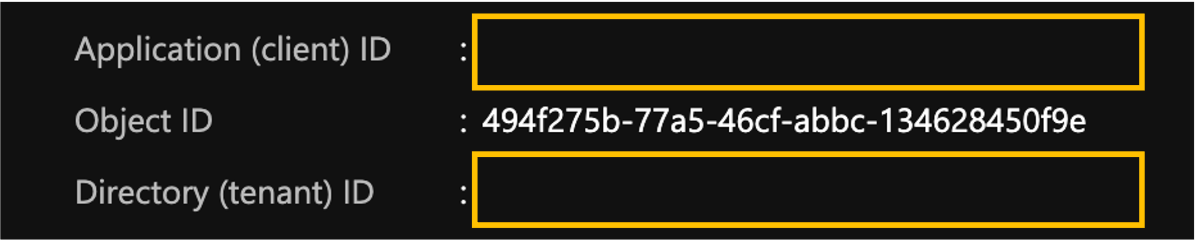

IDs & Secrets
https://portal.azure.com/#blade/Microsoft_AAD_IAM/ActiveDirectoryMenuBlade/RegisteredApps

Slide 27
IDs & Secrets

Slide 28
PRODUCTION TIME

Slide 29
RULES THAT HAS TO BE FOLLOWED
Every API Call has its limitations (calls per Hour, execution time, permissions,…)
Client secret & Generated Token has its own lifespan and after expiration you have to create a new one!
Power BI Desktop will allow you to do a little more then your dataset really can in Power BI Service. But Dataflow will save you!
Dataflows store entities/tables as a type table. If loaded query output is text, number etc... Dataflow natively converts it. To prevent it you have to disable the load of query.
Data Sources that use Anonymous authentication are automatically given the privacy level Public!!!

Slide 30
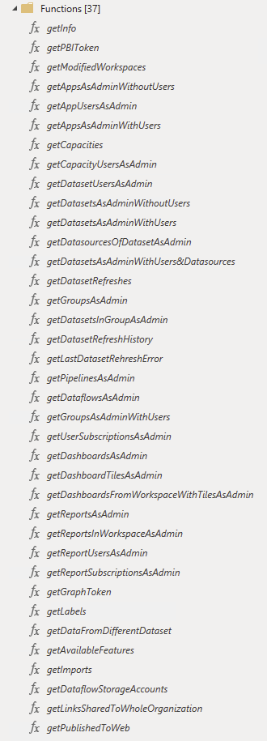
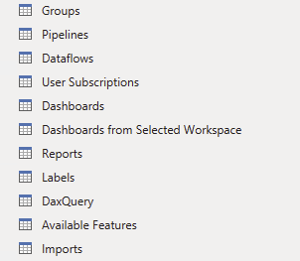
Lets build Dataset from functions
GitHub - tirnovar/Power_BI_REST_API_PQ

Slide 31
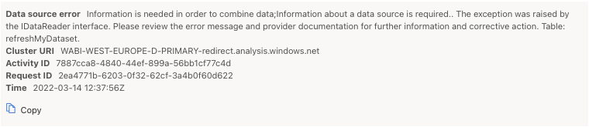

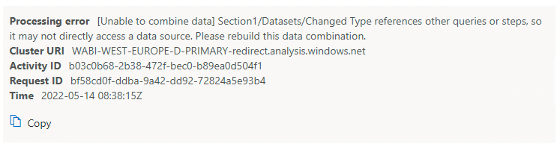
What Will will see on refresh in PBIS?

Slide 32
How to make it work?
❌
✅
Chris Webb's BI Blog: Power BI Data Privacy Levels And Cloud /Web-Based Data Sources Or Dataflows Chris Webb's BI Blog (crossjoin.co.uk)

Slide 33
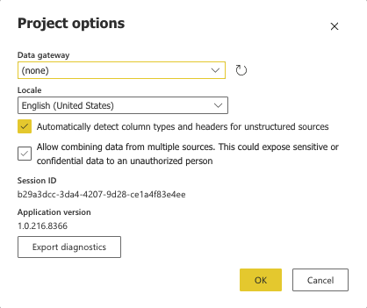
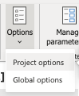
How to make it work?

Slide 34
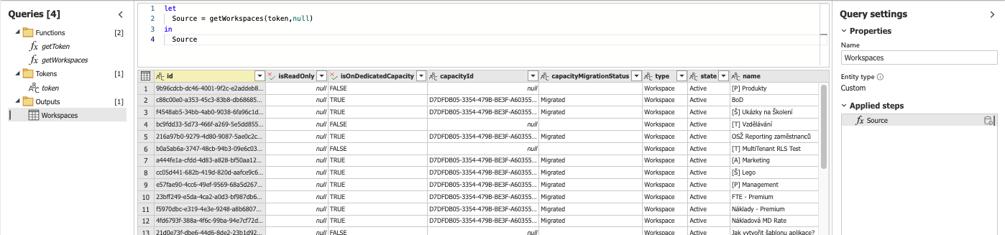
Data showtime

Slide 35

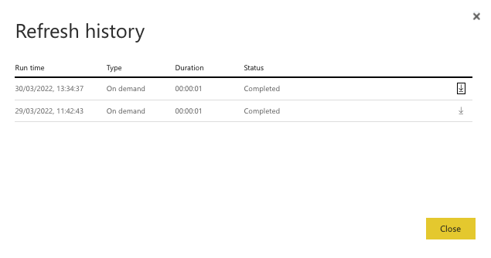
What about the refresh now?

Slide 36
DO I NEED TO BUILD IT FROM SCRATCH? (Template)

Slide 37


NO! HERE IS TEMPLATE
Power_BI_REST_API_PQ/template.json at main · tirnovar/Power_BI_REST_API_PQ (github.com)

Slide 38
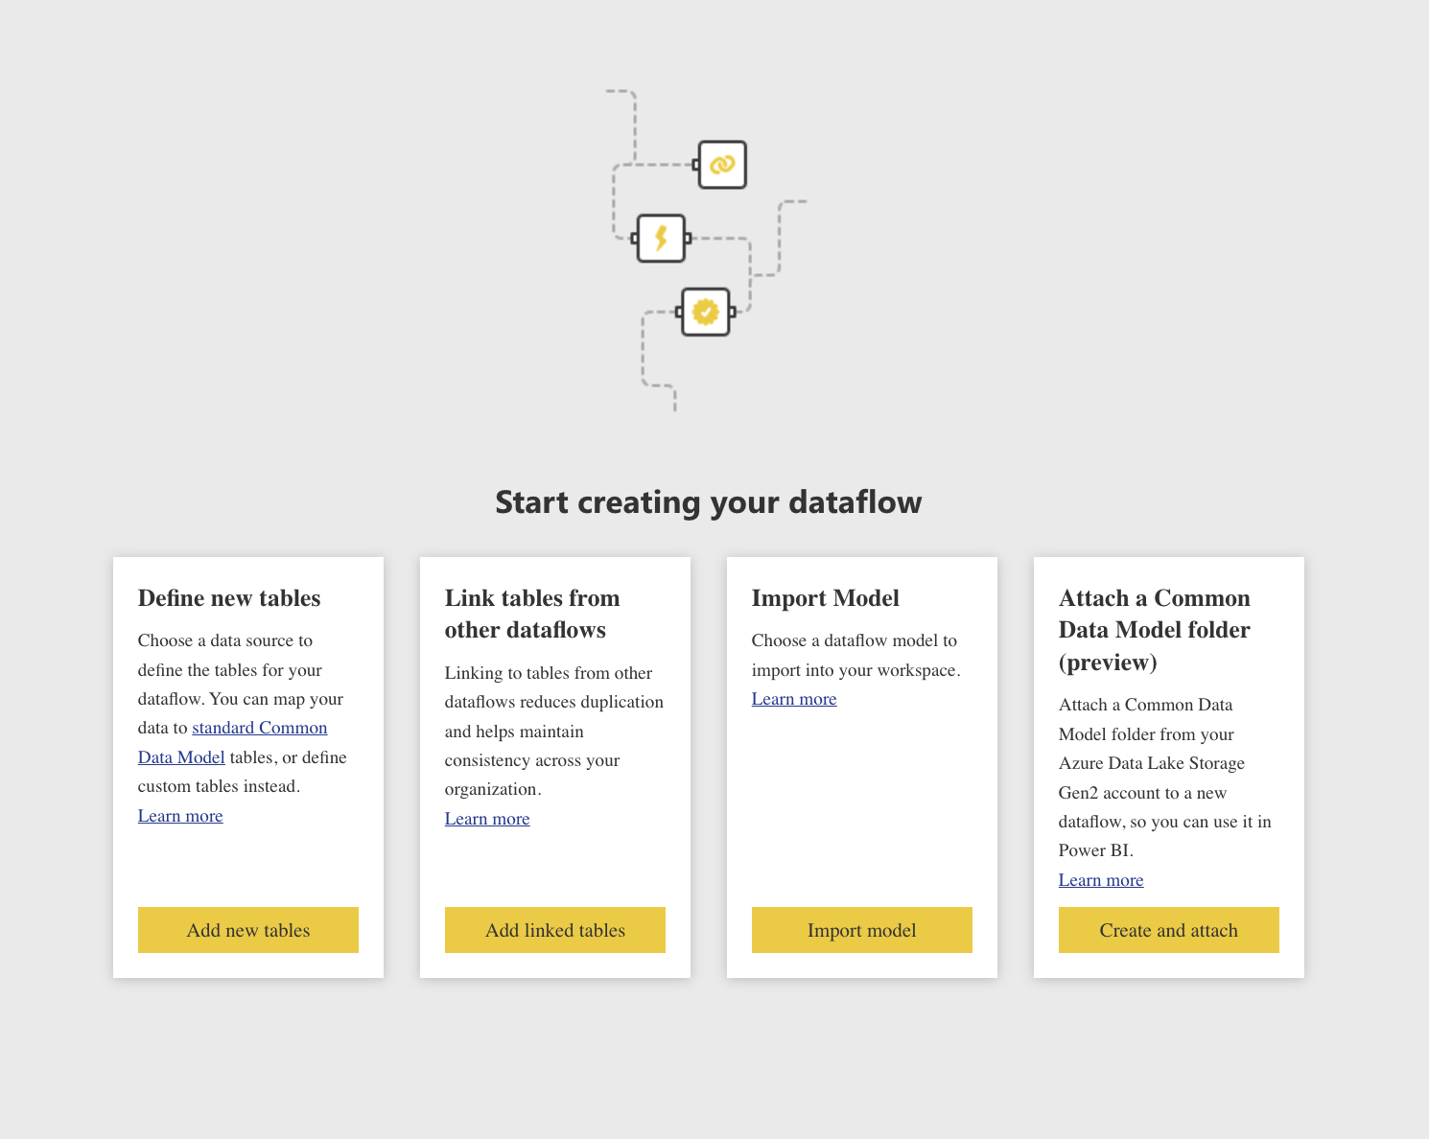
IMPORT

Slide 39
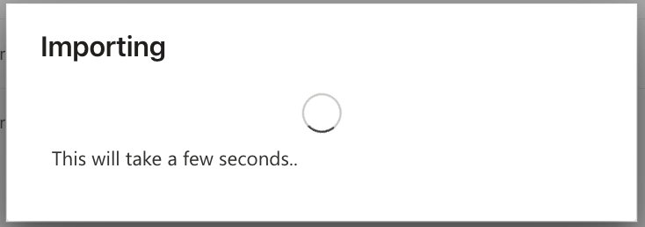
IMPORT

Slide 40
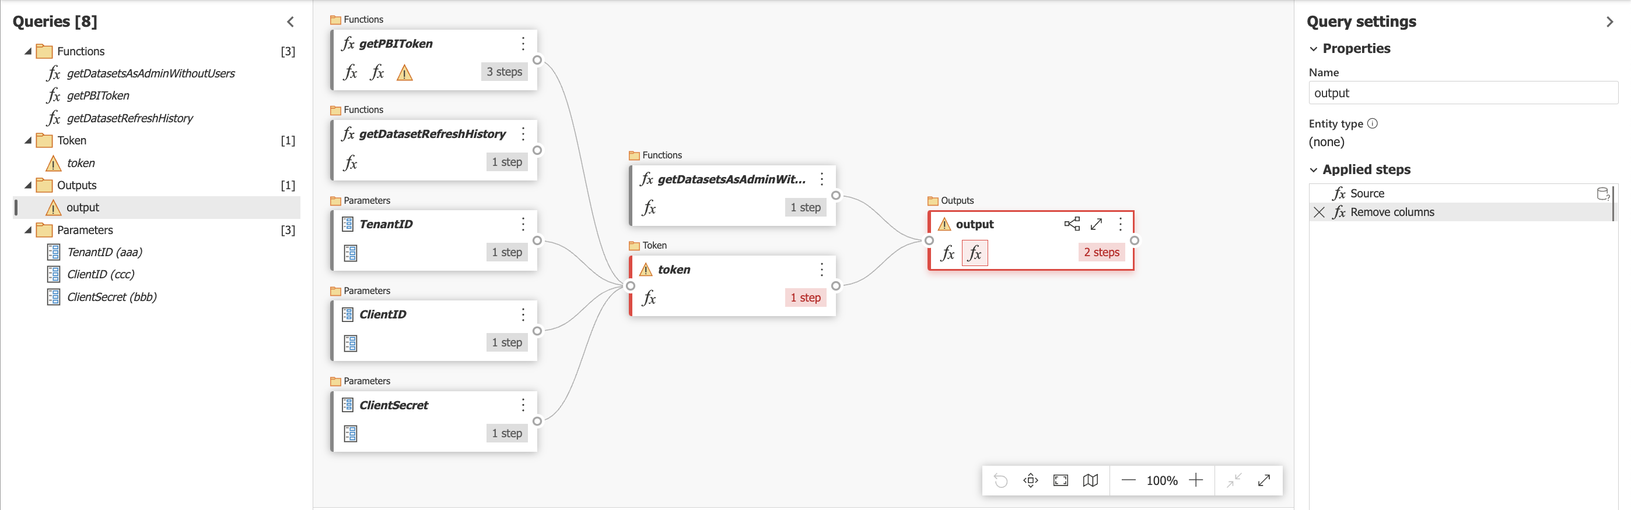
TEMPLATE CONTENT
FILL PARAMETERS, AND YOU ARE READY TO GO!

Slide 41
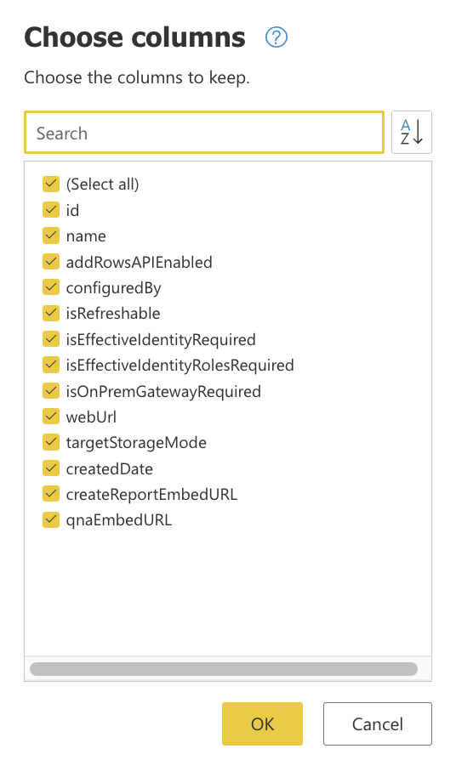
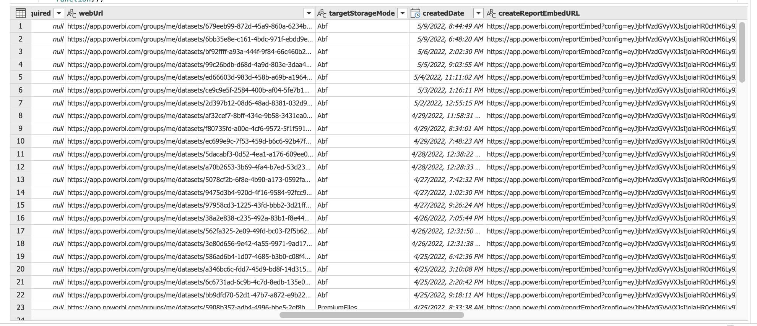
TEMPLATE OUTPUT

Slide 42
THANK YOU FOR THE ATTENTION

